Slide 1
Analytical modeling of part supply process in a bin-kanban system with logistic trains
Fabio Bursi, Elisa Gebennini,
Andrea Grassi, Bianca Rimini

Slide 2
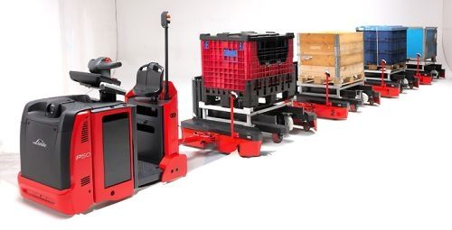
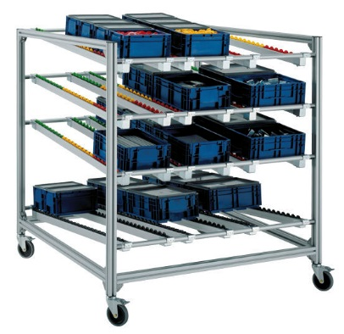
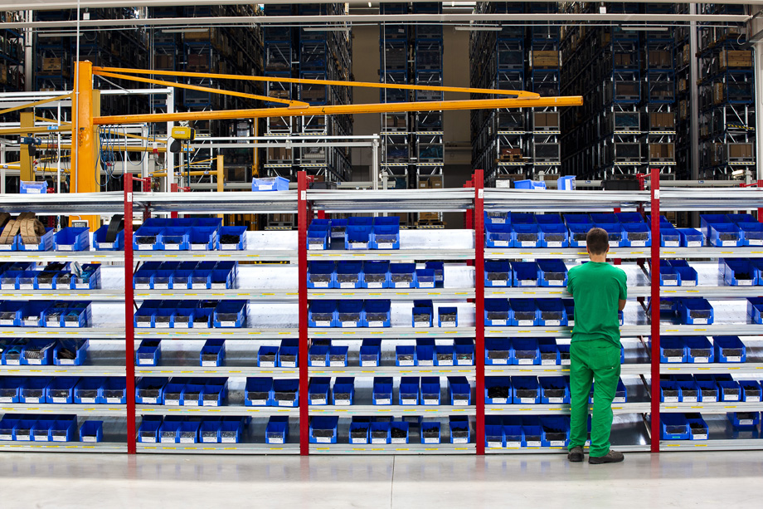
Motivation
Part-supply process in a mixed-model assembly line made up of a number s of stations served by a logistic train.
bin-kanban: an empty bin represents a request for a replenishment

Slide 3
Goal
Objective: to analytically model the system in order to support
the dimensioning of the rack lanes at the assembly stations
the choice of the capacity of the logistic train
Number and dimensions of the wagon

Slide 4
Problem statement
Our idea is to model the bin-Kanban system as a capacitated polling system with
s queues → stations
single server → logistic train
The logistic train follows a single fixed route and visits each station in a cyclic and fixed manner;
The duration of a route is a stochastic variable;
Focus on the withdrawal of the empty bins;
Bins are supposed of identical standardized size;
Arrival process of empty bins at each station is a Poisson process;
Service times is exponentially distributed;
Notes:
Replenishment can be supposed to occur in mask-time

Slide 5
Assumptions
s queues of jobs and a single server;
jobs arrive at the queues according to a Poisson process;
service times are exponentially distributed;
the server inspects the queues in a cyclic and fixed order;
as soon as the server complete a cycle, it is able to start the next cycle with the maximum capacity K available (no supermarket);
switchover times are neglected;
each queue may contain an unbounded number of jobs;
for each cycle, the server can process K jobs at most.

Slide 6
Notation
$λ_{j}$: arrival rate of jobs at queue j;
$μ_{j}$: service rate of jobs at queue j;
$ρ_{j}=\frac{λ_{j}}{μ_{j}}$ load offered at queue j. The total load of the system is 𝜌$=\sum_{j=1}^{s}{ρ_{j}}$;
$a_{j}=\frac{λ_{j}}{ρ}$ parameter introduced to address the model with the power-series expansions of the state probabilities in terms of the load 𝜌;
$K$the server capacity per cycle;
$N_{j}$ number of jobs in queue j;

Slide 7
Capacitated polling system
…
i
…
…
…
2
…
…
…
1
…
s
up to K jobs

Slide 8
Capacitated polling system
…
i
…
…
…
2
…
up to K jobs
(if no service in 1)
…
…
1
…
s

Slide 9
Capacitated polling system
…
i
up to K jobs
(if no service in 1,.., i-1)
…
…
…
2
…
…
…
1
…
s

Slide 10
Capacitated polling system
…
i
…
…
…
2
…
…
…
1
…
s
up to K jobs
(if no service in 1,…, s-1)

Slide 11
… consequently…
We introduce a reformulation of the so-called li-limited polling problem:
in a li-limited polling system the server can process at most li jobs at each queue i
in the proposed model the server can process at most K jobs per cycle (i.e., by considering all the s queues)

Slide 12
Similarly as in Blanc (1992)* the queue length process is transformed into a Markov process by introducing a polling table
iK
…
…
(i-1)K+2
i
(i-1)K+1
Supplementary variable H indicating the actual position on the table;
L=sK table length;
…
2K
…
…
…
2
…
K+2
K+1
…
(s-1)K+1
…
2
1
1
…
(s-1)K+2
s
…
…
K
sK
* Blanc, J.P.C. 1992. An algorithmic solution of polling models with limited service disciplines. Communications, IEEE Transactions on 40(7) 1152–1155.

Slide 13
Polling Table
The value of the variable H:
is increase by one whenever a service has been completed or when queue l(H) is empty, unless the whole system has become empty or the server capacity is full
is set to 1 when the system is empty or the server becomes full
* Blanc, J.P.C. 1992. An algorithmic solution of polling models with limited service disciplines. Communications, IEEE Transactions on 40(7) 1152–1155.
Notes:
Creare animazioni per tenere meglio il filo del discorso

Slide 14
Polling Table
The value of the variable H:
is increase by one whenever a service has been completed or when queue l(H) is empty, unless the whole system has become empty or the server capacity is full
is set to 1 when the system is empty or the server becomes full
New aspect with respect to Blanc (1992)*
→ New variable ψ representing the available capacity of the server before processing a new job at a certain queue.
* Blanc, J.P.C. 1992. An algorithmic solution of polling models with limited service disciplines. Communications, IEEE Transactions on 40(7) 1152–1155.

Slide 15
System state
Thus, let
$\overline{N}=(N_{1}, …,N_{s})$ be the vector of the number of jobs in the queues, with values $\overline{n}=(n_{1}, …,n_{s})$
H be supplementary variable H indicating the actual position on the polling table, with values h=1,…, sK
Ψ representing the available capacity of the server before processing a new job at a certain queue, with values ϕ (depending on K and the position h)
The state of the system is
$$S=(\overline{n},h,\text{ψ})$$
The state probability is denoted by $p(\overline{n},h,\text{ψ})$
Notes:
Dire che descriviamo analiticamente il sistema attraverso le equazioni di bilanciamento

Slide 16
Example
s=3
K=2
How to get state ((2,1,0),1,K) ?
…
2
…
1
…
3

Slide 17
…
2
…
2
$$μ_{2}$$
…
1
…
3
…
1
…
3

Slide 18
…
2
…
2
$$μ_{3}$$
…
1
…
3
…
1
…
3

Slide 19
…
2
…
2
$$λ_{1}$$
…
1
…
3
…
1
…
3

Slide 20
…
2
…
2
$$λ_{2}$$
…
1
…
3
…
1
…
3

Slide 21
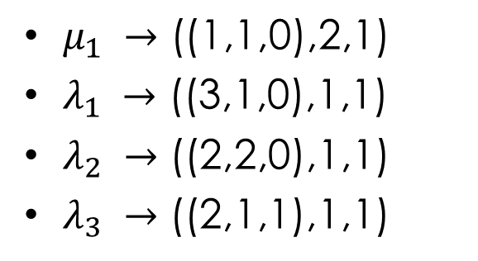
Example
How to leave the state ((2,1,0),1,K) ?
$μ_{1} →\text{((1,1,0),2,1)}$
$λ_{1} →\text{((}\text{3}\text{,1,0),}\text{1}\text{,1)}$
$λ_{2} →\text{((}\text{2}\text{,}\text{2}\text{,0),}\text{1}\text{,1)}$
$λ_{3} →\text{((}\text{2}\text{,1,}\text{1}\text{),}\text{1}\text{,1)}$
…
2
…
1
…
3

Slide 22
Balance equations
In general,
when h=1
The model proposed can be addressed by means of the so-called power-series algorithm (PSA) as in Blanc (1998, 1990, 1992b)
*Blanc, J. P. C. 1998. The power-series algorithm for polling systems with time limits. Probability in the
Engineering and Informational Sciences 12 221–237.
*Blanc, J.P.C. 1990. A numerical approach to cyclic-service queueing models. Queueing Systems 6(1) 173–188.
*Blanc, J.P.C. 1992b. Performance evaluation of polling systems by means of the power-series algorithm.
Annals of Operations Research 35(3) 155–186.

Slide 23
Conclusions
The current analytical formulation of the capacitated polling system suffers of two main assumptions:
switchover times are neglected
times between consecutive cycles are neglected (it can be also treated as a switchover time)
but can provide support for:
- the dimensioning of the the logistics train;
- the dimensioning of the rack lanes at the assembly stations;
and provide approximate system information ( avg waiting time, empty bins in the system, ...)
Notes:
Finally, the critical evaluation of the limitations of the model in representing a real bin-kanban system suggests that further research is required to take into consideration switchover times and the time between
consecutive cycles when the logistic train stands still at the supermarket where empty bins are Refilled
… neverthess we know that other authors have studied….
… a decomposition relationship between the expected waiting times in the zero- and nonzero-switchover times models.
Moreover, in several applications the logistic train stands still at the supermarket, at the end
of each tour, for a fixed period of time. Hence, the time between two consecutive cycles can be
described as a constant switchover time.

Slide 24
…Thank you for your attention…

